Slide 1

Forecasting Stock Prices with A Hybrid LSTM Approach Paper review: An Advisor Neural Network framework using LSTM-based Informative Stock Analysis (Fausto Ricchiuti, Giancarlo Sperlí)
Christopher Joshua – chrisjosh1097@gmail.com

Slide 2
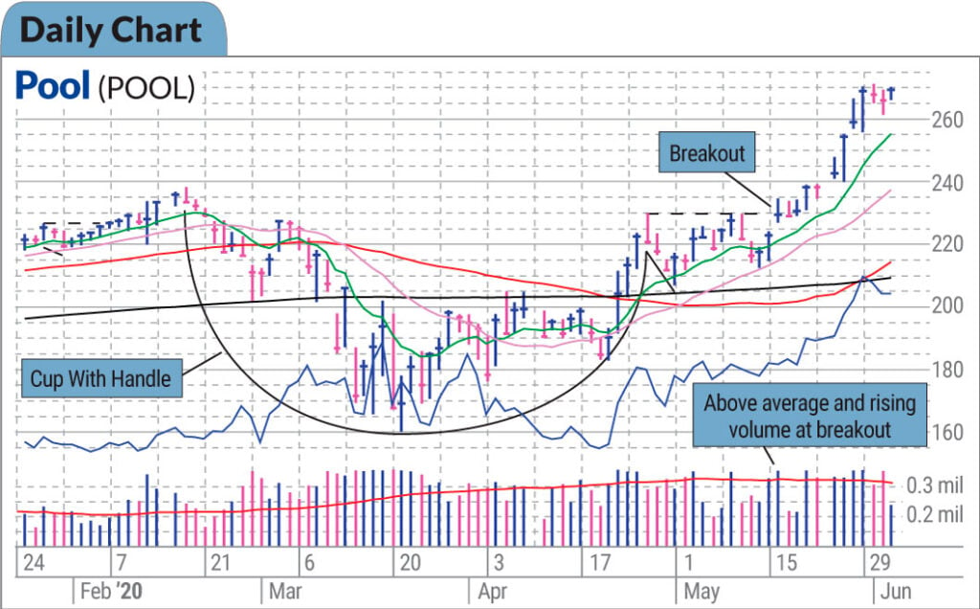
WHY FORECASTING MATTERS?
Stock price prediction may help in:
Investors making informed decisions
Institutions manage risk and spread
Traders identifying market opportunities
Traditional methods struggle with non-linearity and volatility

Slide 3
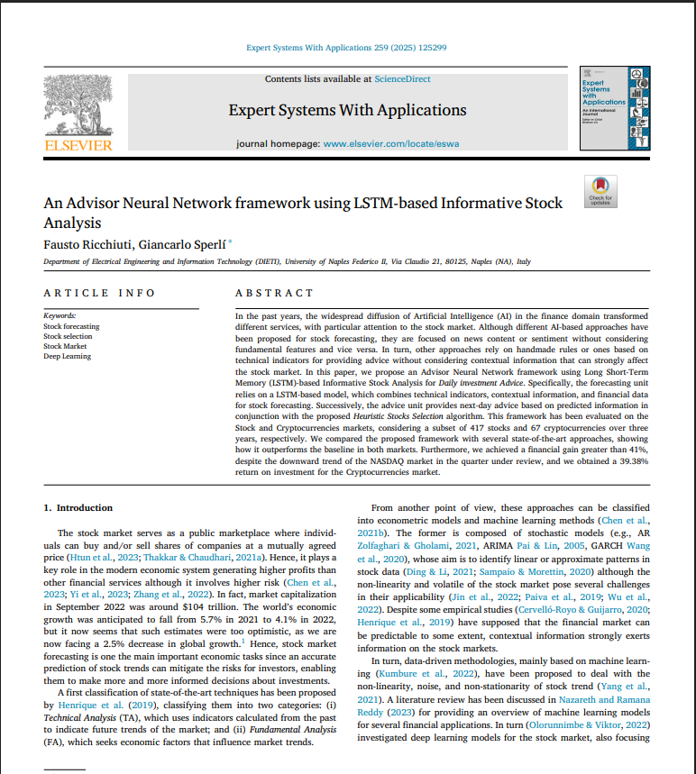
PAPER OVERVIEW
Objective: Compare LSTM and ARIMA models in forecasting TCS stock prices over short and long-term periods.
Models Evaluated:
ARIMA Statistical model
LSTM – Deep learning model
Results:
Short-Term (10 days): ARIMA performed better
Long-Term (60 days): LSTM showed slight advantage
Metric used: RMSE
Insights:
ARIMA excels in short horizon
LSTM captures longer patterns
No feature engineering or tuning

Slide 4
GOAL OF IMPLEMENTING STUDY
Objective: Predict closing price using past data
Focus: Combine historical price data + Relevant parameters + LSTM neural networks
Emphasis: Short-term and long-term forecasting (ARIMA vs LSTM)

Slide 5
RELEVANT PARAMETERS
RSI (Relative Strength Index): Measures recent price momentum and adding more weights.
MACD (Moving Average Convergence Divergence): Captures trend direction of the trend
Moving Average: Smooths fluctuations to show trend

Slide 6
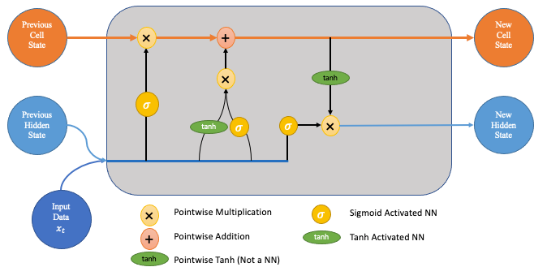
LSTM (Long Short-Term Memory)
A type of Recurrent Neural Network (RNN)
Captures time dependent patterns
Used for:
Stock price trends
Weather forecasts
Natural language processing

Slide 7
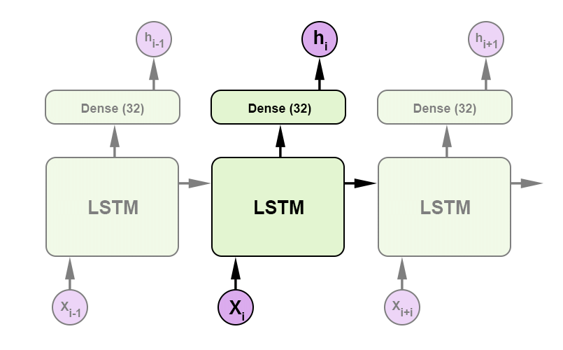
MODEL ARCHITECTURE
Inputs:
Sequences of 20 past days’ data
Relevant parameters
Layers: LSTM → Dropout → Dense
Output: Predicted closing price for the next day

Slide 8
DATASET
Source: Yahoo Finance (WMT stock)
Time range: 2018–2024 (6 years)
OHLCV (Open, High, Low, Close, Volume)
Relevant Parameters: RSI, MACD, MA10
Pulled using Yahoo Finance API, Calculated MA10, RSI and MACD.

Slide 9
BASELINE MODEL & EVALUATION METRICS
Base Model For Comparison:
ARIMA: Statistical model for time series
Metrics:
MAPE (Mean Absolute Percentage Error)
RMSE (Root Mean Squared Error)

Slide 10
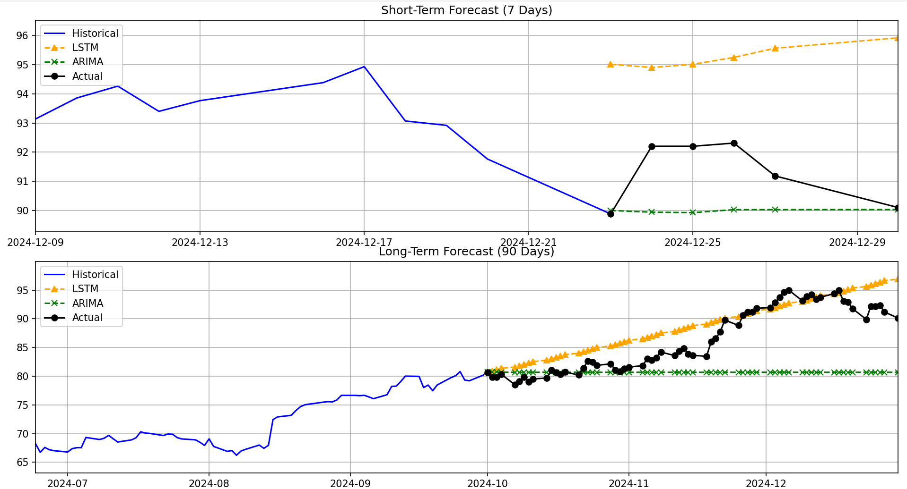
FORECASTGraph

Slide 11
RESULTS
Model | Forecast Horizon | RMSE | MAPE
LSTM | 7 Days | 2.60 | 2.59%
ARIMA | 7 Days | 1.67 | 1.48%
LSTM | 30 Days | 6.19 | 5.04%
ARIMA | 30 Days | 7.86 | 6.56%

Slide 12
CONCLUSION & INSIGHTS
Short-term: ARIMA outperforms LSTM (lower RMSE & MAPE).
Long-term: LSTM performs better than ARIMA over 90 days.
LSTM trend capture: Handles longer-term trends better.
ARIMA strength: More accurate in short, stable periods.

Slide 13
LIMITATIONS AND RISKS
LSTM simplicity: Shallow model, no tuning or validation.
Missing features: Only uses closing price, ignores volume/news/sentiment.
Overfitting risk: No early stopping or regularization.
ARIMA assumption: Requires stationarity, may not hold in stocks.
Limited evaluation: Only 7-day and 90-day tested on a single stock.

Slide 14
FUTURE WORK RECCOMENDATIONS
Add new features: Volume, news sentiment, etc.
Tune models: Optimize LSTM layers, dropout, window size.
Try hybrids: Combine ARIMA + LSTM or use Transformers.
Generalize: Test on more stocks especially with more volatility.
Forecast confidence: Add uncertainty bands or probabilistic models

